Slide 1
Getting Started with Assembly Language
Some material taken from Assembly Language for x86 Processors by Kip Irvine © Pearson Education, 2010
Slides revised 2/2/2014 by Patrick Kelley

Slide 2
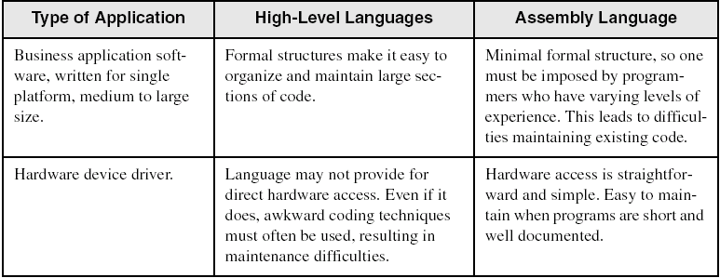
Comparing ASM to High-Level Languages

Slide 3
Translating Languages
English: Display the sum of A times B plus C.
C++: cout << (A * B + C);
Assembly Language:
mov eax,A
mul B
add eax,C
call WriteInt
Intel Machine Language:
A1 00000000
F7 25 00000004
03 05 00000008
E8 00500000

Slide 4
Binary Numbers
Digits are 1 and 0
1 = true
0 = false
MSB – most significant bit
LSB – least significant bit
Bit numbering:

Slide 5
Integer Storage Sizes
Standard sizes:
The above chart is for Intel x86 processors. In MIPS, a word is 32 bits, a half-word is 16 bits and there is no ‘quadword’. A byte is still a byte.
What is the largest unsigned integer that may be stored in 20 bits?

Slide 6
Ranges of Signed Integers
The highest bit is reserved for the sign. This limits the range:
Storage Type | Range(low-high) | Powers of 2
Signed byte | -128 to +127 | -2⁷ to (2⁷-1)
Signed half-word | -32,768 to +32767 | -2¹⁵ to (2¹⁵-1)
Signed word | -2,147,483,648 to + 2,147,483,647 | -2³¹ to (2³¹-1)
Practice: What is the largest positive value that may be stored in 20 bits?

Slide 7
Character Storage
Character sets
Standard ASCII (0 – 127)
Extended ASCII (0 – 255)
Unicode (0 – 65,535)
SPIM System IO only handles ASCII
Null-terminated String
Array of characters followed by a null byte
Using the ASCII table
Appendix B in MIPS book

Slide 8
Basic Microcomputer Design
clock synchronizes CPU operations
control unit (CU) coordinates sequence of execution steps
ALU performs arithmetic and bitwise processing

Slide 9
MIPS Architechture
Program Counter
Instruction Register
ADDRESS
Memory
Control Logic
Register
File
ALU
Rs
Rt
Rd

Slide 10
Instruction Execution Cycle
Fetch
Memory at PC moved to IR
Decode
Opcode to ALU
Register Operands selected
Immediate Operand to ALU
Fetch operands
In other architectures but not MIPS
Execute
Store output
Register to Memory operation (MIPS)
PC Incremented
Instruction Addresses on 4-byte boundary
Branch may change PC instead of incrementing

Slide 11
Addressable Memory
Addresses are 32 bits
2³² locations = 4GB = 4,294,967,296 locations
The ‘B’ in GB stands for ‘bytes’
Range is 0 to 2³²-1
Half-word
16 bits or 2 bytes long
Successive half-words have addresses that increment by 2
Word
32 bits or 4 bytes long
Successive words have addresses that increment by 4

Slide 12
Register ‘File’
MIPS has 32 accessible 32-bit registers
The registers are numbered 0 to 31
They also have short names
The names will indicate the register’s purpose
Purpose may be by convention or design
Special registers may not be user accessible
MIPS includes the IR, PC, and ALU registers
Sometimes special registers are read only
Other architectures have additional registers
Commonly, there is a ‘status’ register
IO port registers are also common.

Slide 13
Register ‘File’ (continued)
Register | Number | Usage
zero | 0 | Constant 0
at | 1 | Reserved for assembler
v0 | 2 | Used for return values from function calls
v1 | 3
a0 | 4 | Used to pass arguments to functions
a1 | 5
a2 | 6
a3 | 7

Slide 14
Register ‘File’ (continued)
Register | Number | Usage
t0 | 8 | Temporary Caller saved Called function need not save or protect these
t1 | 9
t2 | 10
t3 | 11
t4 | 12
t5 | 13
t6 | 14
t7 | 15
t8 | 24
t9 | 25

Slide 15
Register ‘File’ (continued)
Register | Number | Usage
s0 | 16 | Saved Temporary Callee saved Called function must protect these by saving and then restoring before returning to caller
s1 | 17
s2 | 18
s3 | 19
s4 | 20
s5 | 21
s6 | 22
s7 | 23

Slide 16
Register ‘File’ (continued)
Register | Number | Usage
k0 | 26 | Reserved for OS kernel
k1 | 27
gp | 28 | Pointer to global area
sp | 29 | Stack Pointer
fp | 30 | Frame Pointer
ra | 31 | Return Address for function calls

Slide 17
Instruction Format
Register format
Op-code | Rs | Rt | Rd | unused | Function
000000 | SSSSS | TTTTT | DDDDD | 00000 | FFFFFF
Immediate format
Op-code | Rs | Rt | Immediate constant
000000 | SSSSS | TTTTT | IIIIIIIIIIIIIIII
Jump format
Op-code | Target
00001F | TTTTTTTTTTTTTTTTTTTTTTTTTT
Jump destination is PC + (Target Left Shift by 2)

Slide 18
Using Memory
IR addresses memory directly via the PC
MIPS ISA is ‘load/store’
Typically, only a load or store instruction affects memory
All other operations affect only registers
Registers are used to point to memory for load/store
Addressing mode is Base/Displacement
Displacement is also known as Offset
One register will hold a base address, another the displacement
Concatenating the two produces an effective address
Other architectures use different modes
Direct addressing – specifies the location directly
Indirect addressing – part of the address is stored in memory
Indexed addressing – displacement is multiplied by a constant
Segment/offset – used to address large memory

